Slide 1
The Hawk Collective
Java Programming Tutorial

Slide 2
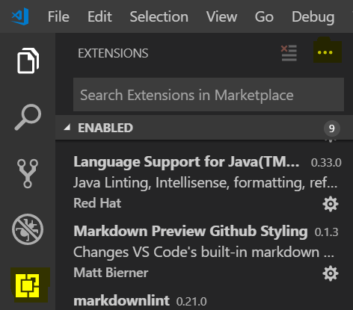
Setting Up Your Environment for Java Development
Download and Install Visual Studio Code
Create a folder to use as a workspace, this is where all of your projects will be stored.
In Visual Studio Code, go to the extensions tab (pictured right) and install the following extensions:
Java Extension Pack from Microsoft
Code Runner from Jun Han
WPI Extension (Select “Install from VSIX from the context menu (...) in the extensions tab
Install the JDK.

Slide 3
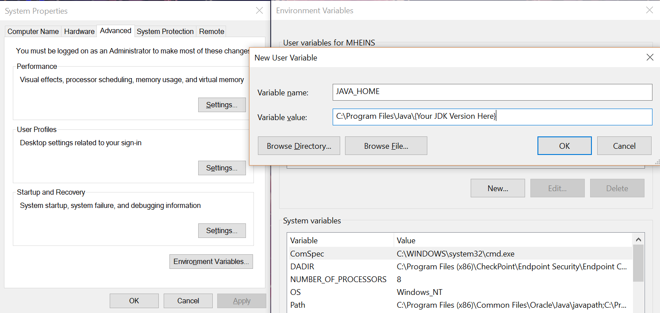
Setting Environment Variables
You may need to set the JAVA_HOME Environment Variable (Search ‘Environment Variable’ to open the window on the left).

Slide 4
Creating a New Java Project in VSCode

Slide 5
Java Program Execution Flow
Java Programs begin execution at a ‘main’ method.
The main method will always have the following method header
[Insert code here]
Java programs will run each line of code sequentially starting with the first line from the main method.

Slide 6
Java Syntax (Grammar)
Java is case-sensitive, ‘test’ and ‘Test’ are processed as two completely distinct words
Each line of code ends in a semicolon ‘;’
By convention, variable and method names are written in what is known as Camel-Case. This means that the first work is lowercase, with following words being capitalized (with no spaces between them) e.g. variableName
Curly braces ‘{}’ are used to denote sections of related code
Lines that begin with ‘//’ or blocks of text bookended with ‘/*’ and ‘*/’ are comments and will not affect program execution

Slide 7
Data Types
Data can be stored in a variety of formats within any programming language.
Java’s basic or ‘primitive’ types:
Int (Integer values)
Boolean (true/false)
Double (decimal values)
Char (character values, e.g. ‘a’)
Long, short, byte, float (These aren’t really that important)
Data can also be stored in Objects and arrays, which will be covered later

Slide 8

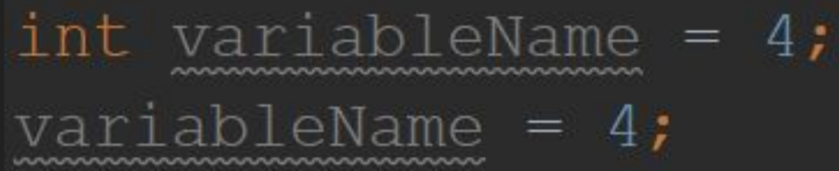
Variables
There are two steps to making a variable in Java, Declaration and Initialization.
Declaration is simply stating the type of the variable, followed by the name
[Insert code here]
This tells the computer to make a variable of type int (integer) called ‘variableName’
Initialization is assigning a starting value to a variable. This can be (but does not have to be) done on the same line as the declaration.
[Insert code here]

Slide 9
Constants
Constants are variables that are declared with the ‘final’ keyword
[Insert code here]
By convention, constants are named in all caps, with underscores ‘_’ used to separate words
Once initialized, constants cannot be changed

Slide 10
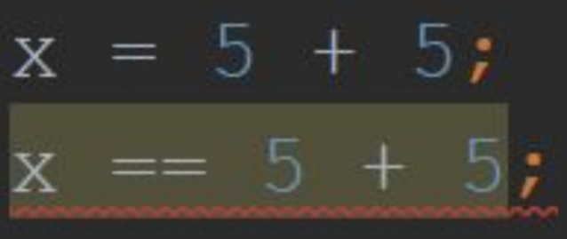
Mathematical Operators
Basic math operators (+, -, *, /) will function as expected including order of operations (When dividing two integers, the result is always rounded down)
A single equals sign ‘=’ is used as the assignment operator. It will make the left side of the statement equal to the right side.
Two equals signs ‘==’ are used to check equality, i.e. is the left side equal to the right side.
In the code below, the first line makes the value of x equal to 5 + 5 (AKA 10), whereas the second line checks to see if x is equal to 5 + 5 (and will evaluate to either true or false)

Slide 11

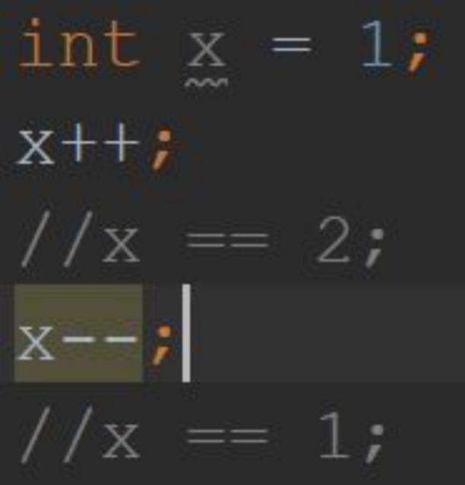
Mathematical Operators 2
The modulo operator ‘%’ is used to take the remainder from dividing two numbers
[Insert code here]
The increment operator ‘++’ and decrement operator ‘--’ can be used to increase or decrease the value of a variable by 1

Slide 12
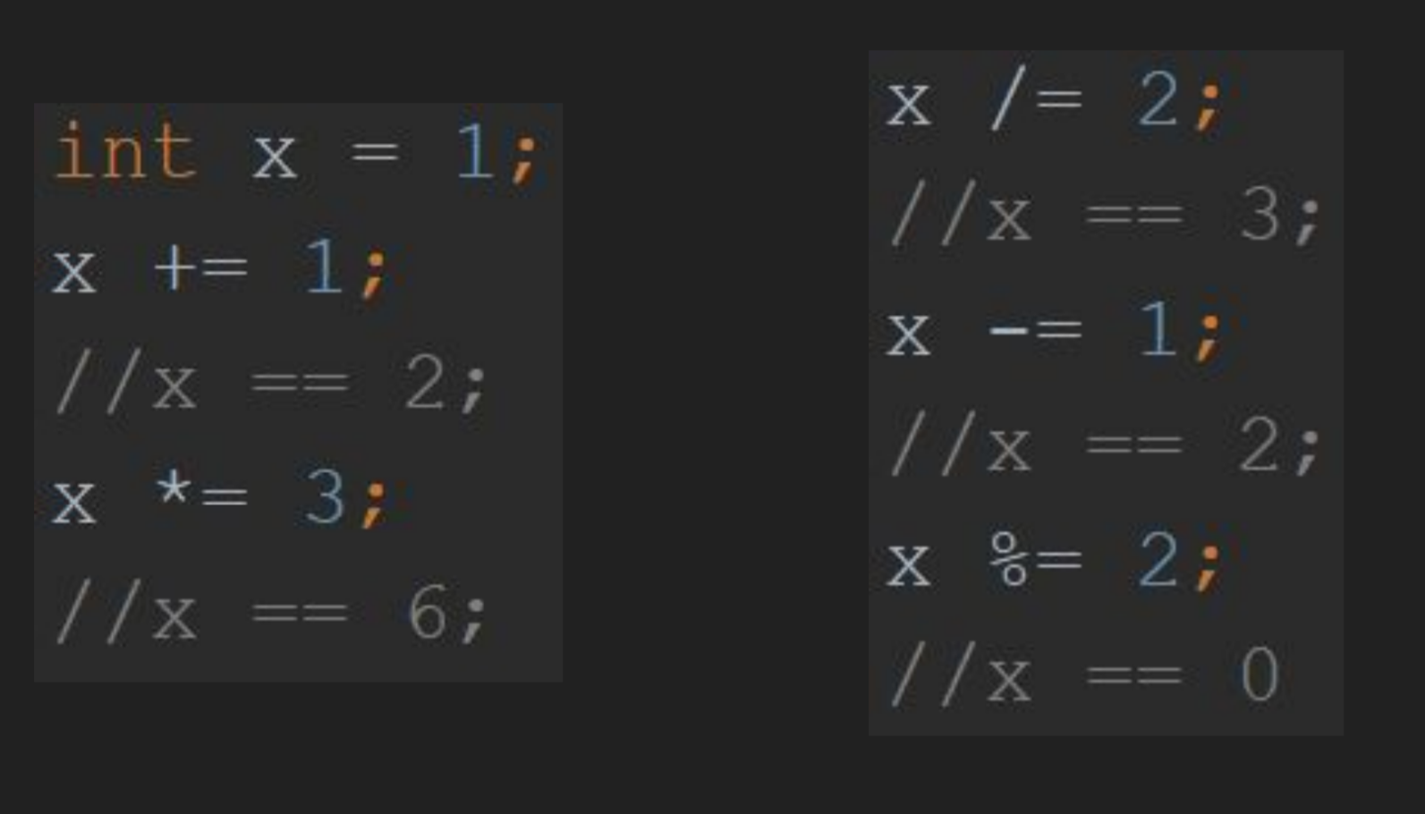
Assignment Operators
You can combine the basic math operators with the assignment operator ‘=’ to change the value of a variable. The statement ‘x += 1’ is equivalent to ‘x = x + 1’

Slide 13
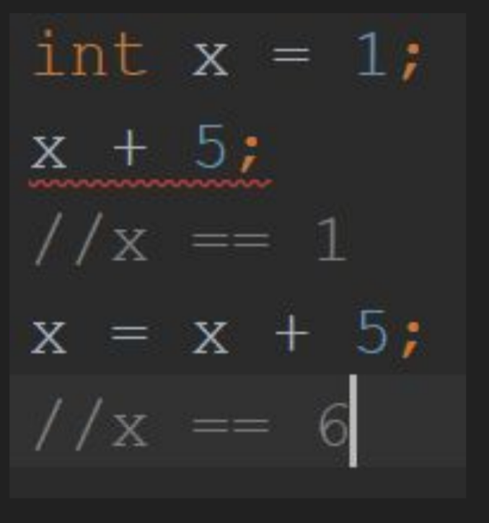
Mathematical vs Assignment Operators
Mathematical operators do not change the value of the variables involved, unless an assignment operator is also used

Slide 14
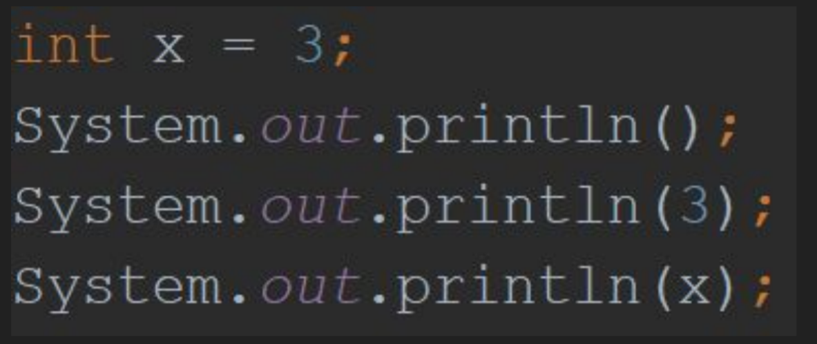
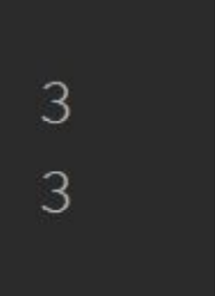
The Print Method
The below method will print a single line to the standard output, typically the command line.
The above code will have the following output

Slide 15
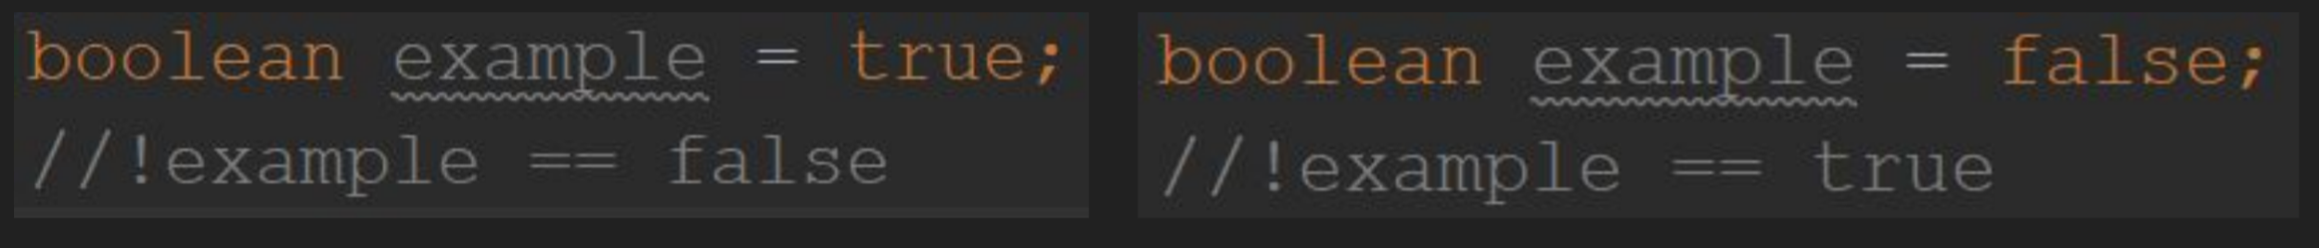
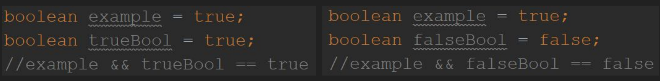
Boolean (Logical) Operators
Boolean operators are those which can affect statements which are evaluated as either true or false
The NOT operator ‘!’ will reverse the true/false state of its operand (what the operator acts on)
[Insert 2 code blocks here]
The AND operator ‘&&’ will evaluate to true if and ONLY if both operands are true
[Insert 2 code blocks here]

Slide 16
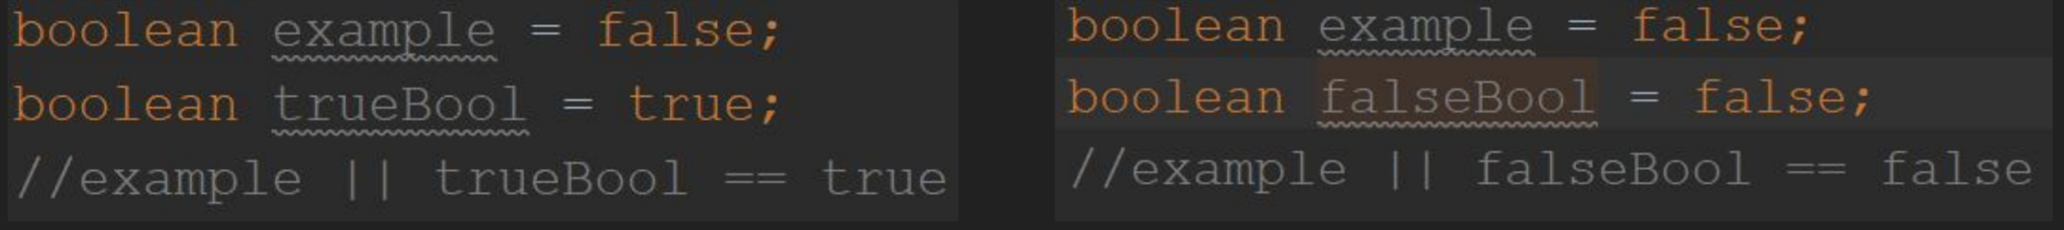
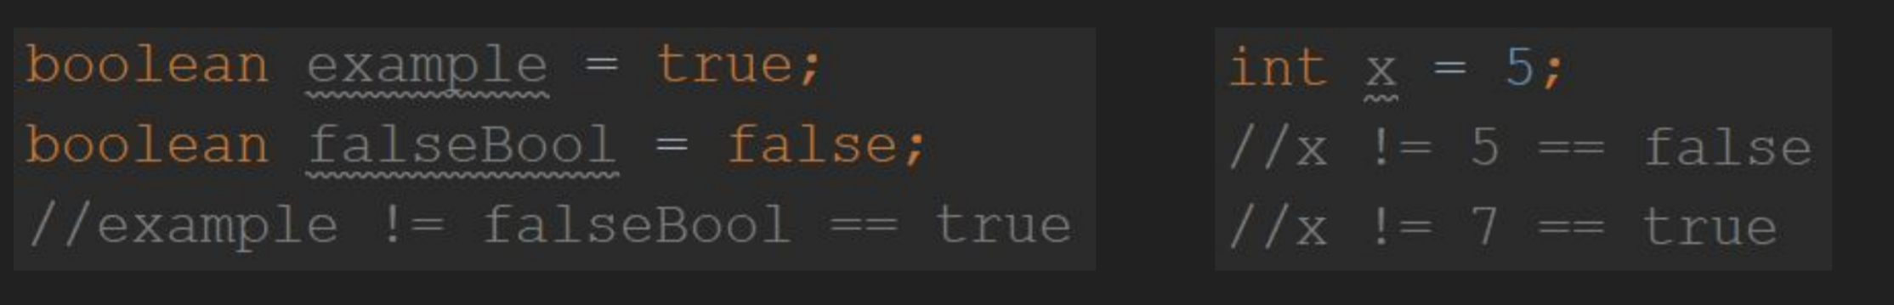
Boolean Operators 2
The OR operator ‘||’ will evaluate to true if either of its operands is true
[Code]
The not equals operator ‘!=’ will evaluate to true if the operands are not equal to one another

Slide 17
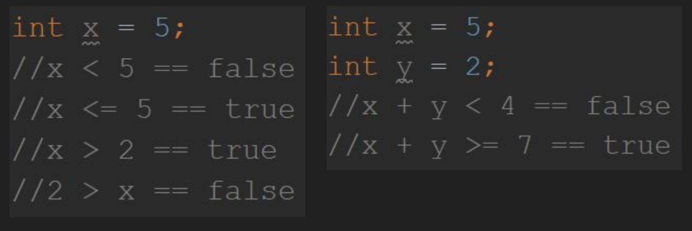
Relational Operators
Relational operators (<, >, <=, >=) will work as you would expect when used with numerical values
[Code]

Slide 18
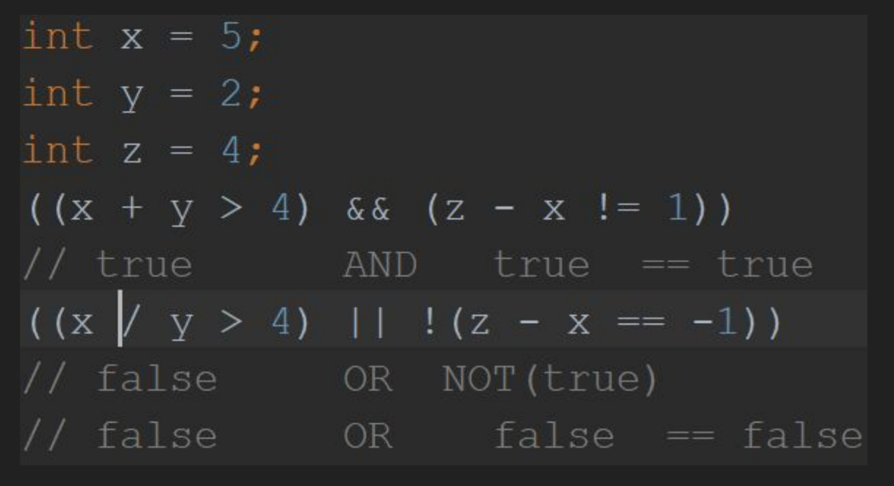
Boolean Expressions
A Boolean Expression is any statement which can be evaluated into true or false. These expressions often chain together multiple boolean operators

Slide 19
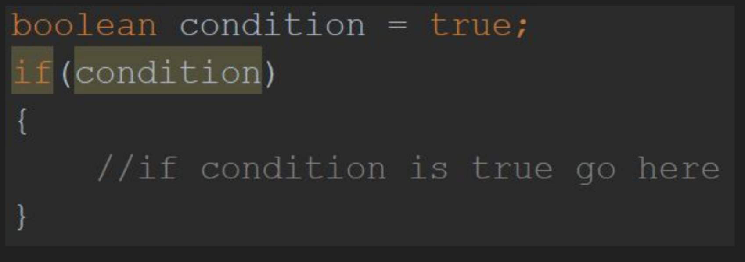
If Statements
If statements are used to make decisions while the program is running. If there is not an open brace ‘{‘ after the if statement, the code block is assumed to only include the line immediately following the condition.
[Code goes here]
A boolean expression, or condition, is placed within the parenthesis ‘()’ and if the expression is true, the block of code is executed. If the condition is false, then the if statement is skipped and the program will resume execution on the line after the closing brace.

Slide 20
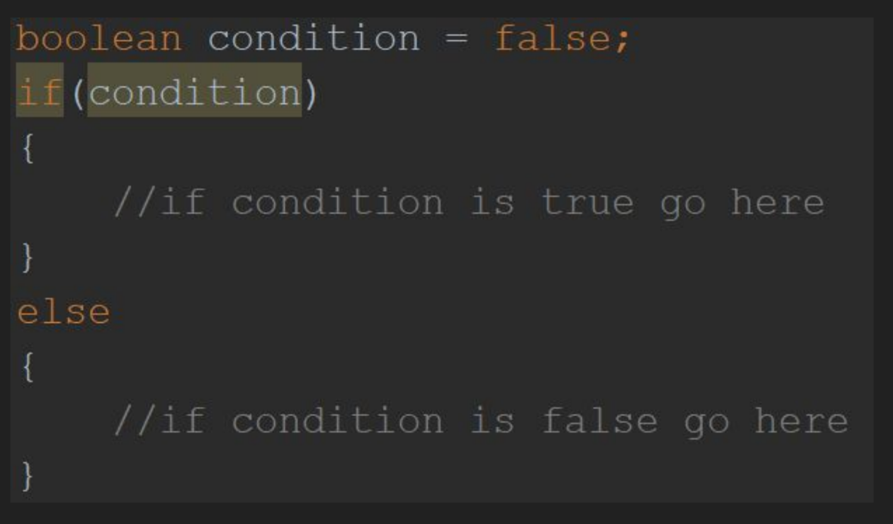
Else Statements
Else statements are blocks of code which are executed only if the condition of the if statement they are preceded by is false.

Slide 21
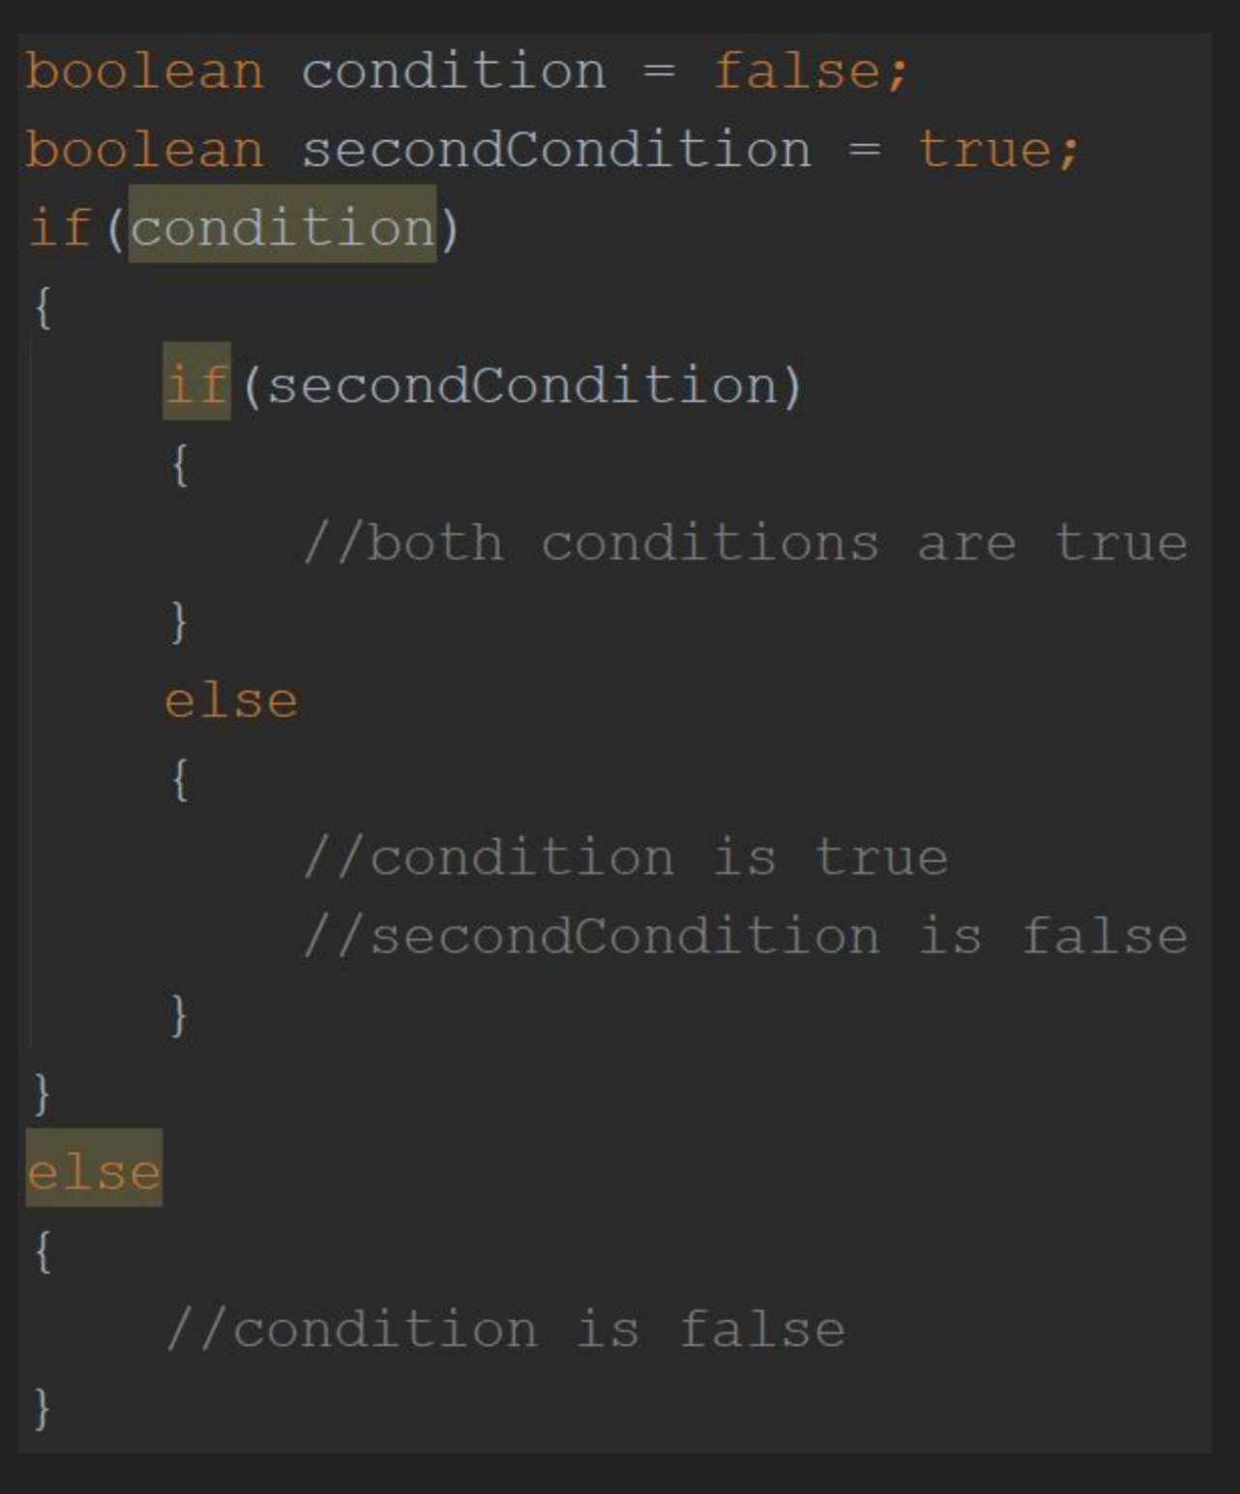
Nested If and Else Statements
If and Else statements can be placed within other if and else statements. These are referred to as ‘nested’ statements.
It is important to keep paired braces at the same indentation level so you can easily see where blocks of code begin and end.

Slide 22
A Variable’s ‘Scope’
‘Scope’ is the part of a program from which something is accessible. For example, if you are within the scope a variable was defined, you can see and use that variable, but if you are outside of the scope you cannot interact with the variable in any way.
In general scope is defined by curly braces ‘{}’, so anything that was defined within a set of braces is visible anywhere else within those braces, including within other nested braces.
This means that variables which are declared within an if statement cannot be used outside of that if statement.

Slide 23
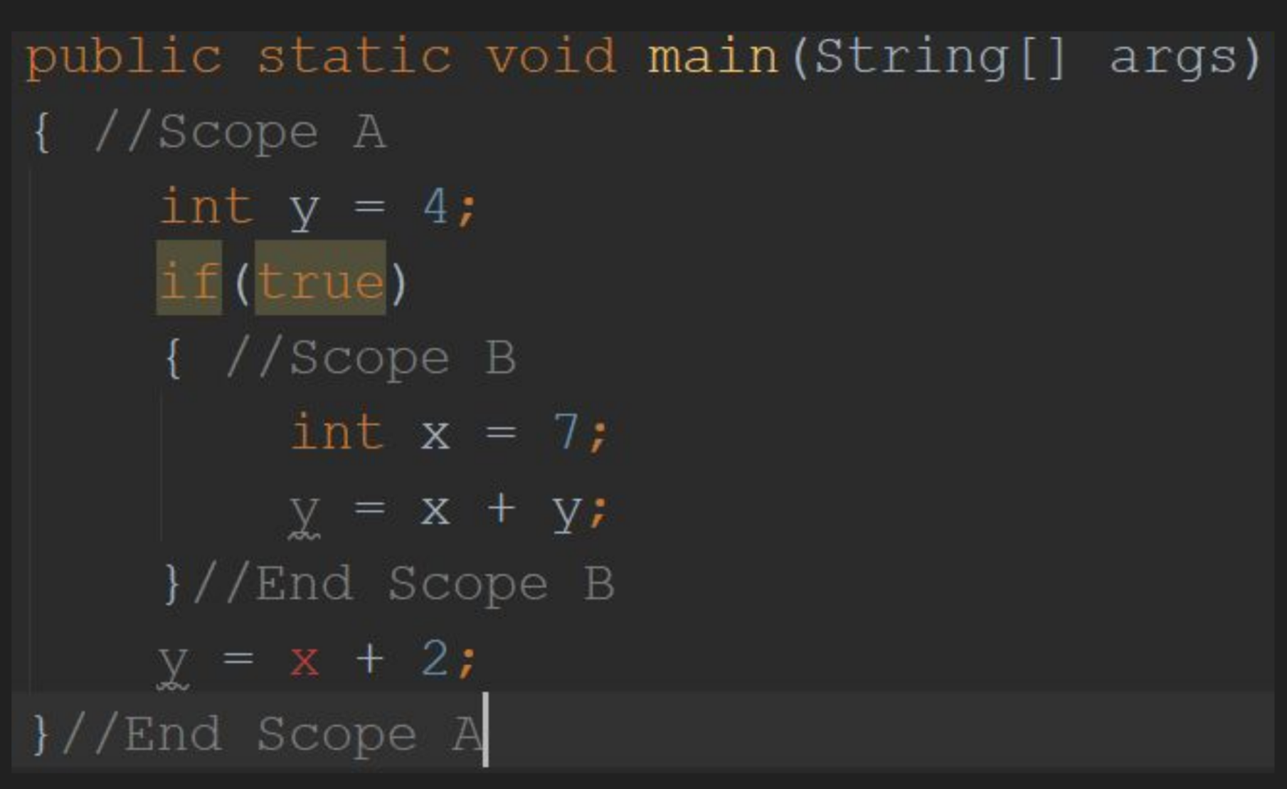
Scope Example
The variable y is defined in scope A, and is therefore usable anywhere within scope A
Variable x is defined in scope B, so is only usable within scope B (The red text color means that there is an error as that line is not within scope B)
Scope B itself is within scope A, therefore anything defined in scope A is usable in scope B (This is why there is no error when using variable y within scope B)

Slide 24
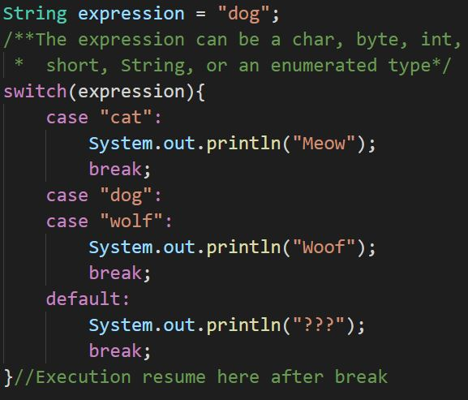
Switch and Break Statements
An alternative to using multiple if statements is to use a switch statement.
A switch statement evaluates the expression then runs all statements following the matching case label.
A break statement can be used to exit the switch statement. After hitting a break statement, program execution will resume with the first statement following the switch statement.

Slide 25
Switch and Break Statements 2
If no case matches the value of the given expression, then execution will move to the default case if present, otherwise it will move to the first statement following the switch statement.

Slide 26
Syntax Errors vs Logic Errors
A Syntax Error is something that breaks the rules of the language and cannot be executed. Referencing a variable that has not been defined, or leaving out a semicolon are examples of syntax errors.
A Logic Error is code that does not break the rules of the language, but which will not produce the desired output or behavior. A calculator which says ‘2 + 2 = 5’ or a robot that moves backwards when told to move forwards are examples of logic errors.

Slide 27
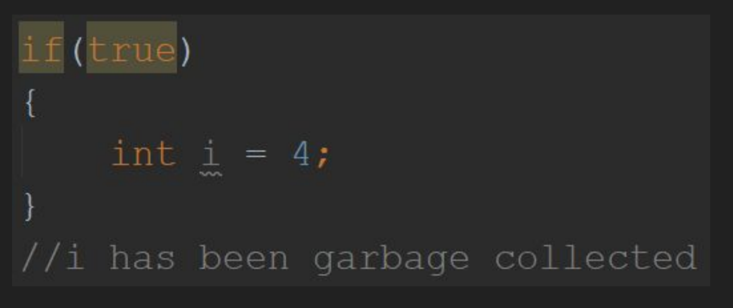
Garbage Collection
When a program reaches the end of a certain scope (end of a loop, if statement, method, etc.) any references to variables which were created in that scope are deleted.
Any variables which do not have any references pointing to them are automatically deleted, this process is known as garbage collection.

Slide 28
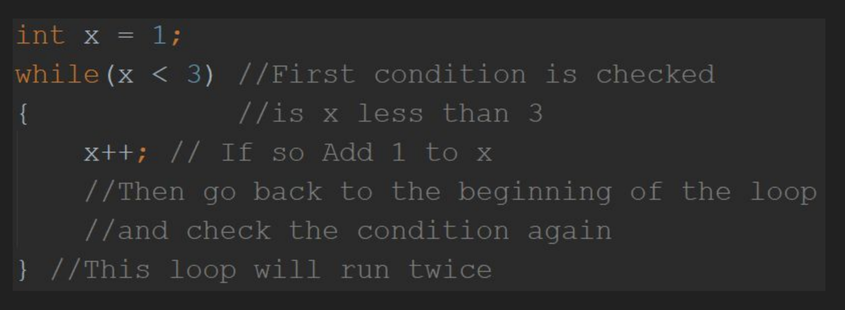
While Loops
[Code Here]
A while loop is a block of code that will continue to repeat itself ‘while’ a condition (boolean expression) is true.
The condition is checked for ‘truthiness’ prior to each iteration of the loop.
Similarly to an if statement, if the condition is false the block of code within the while loop will never be run.

Slide 29
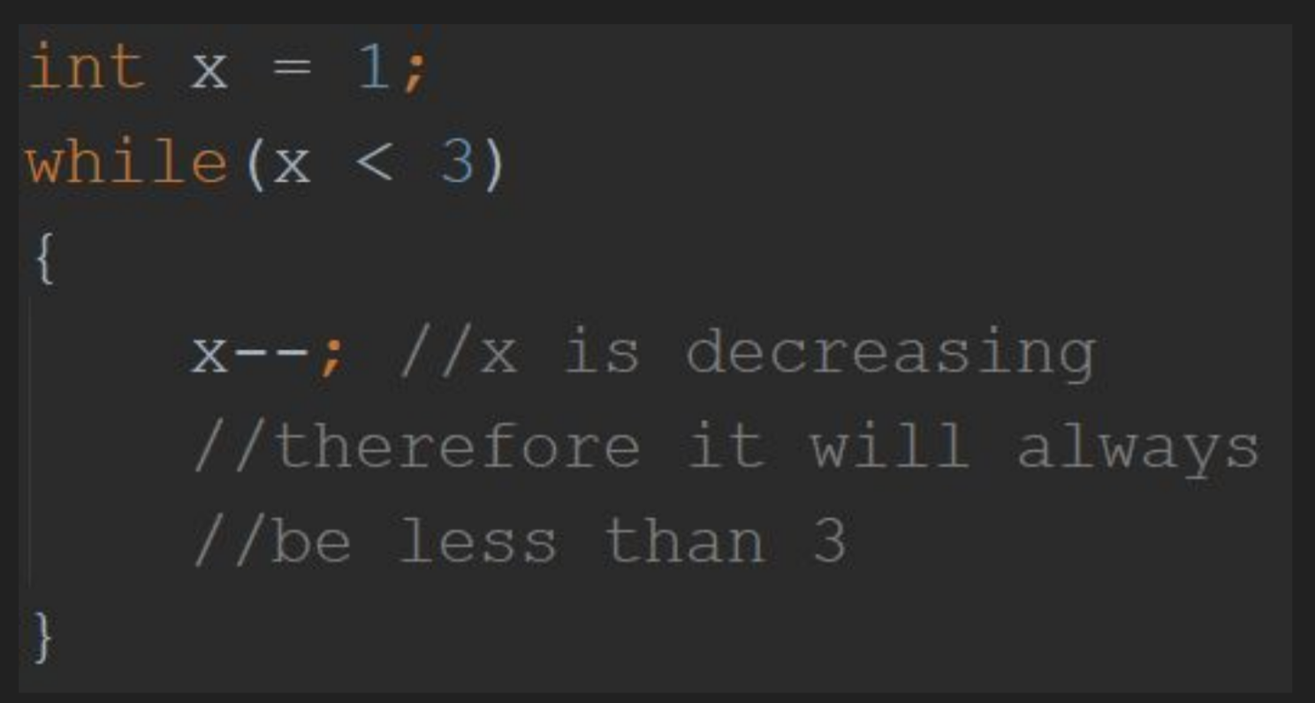
Infinite Loops
It is important to make sure that the condition of a while loop can become false while iterating through the loop.
If the condition cannot become false then the loop will run forever.

Slide 30
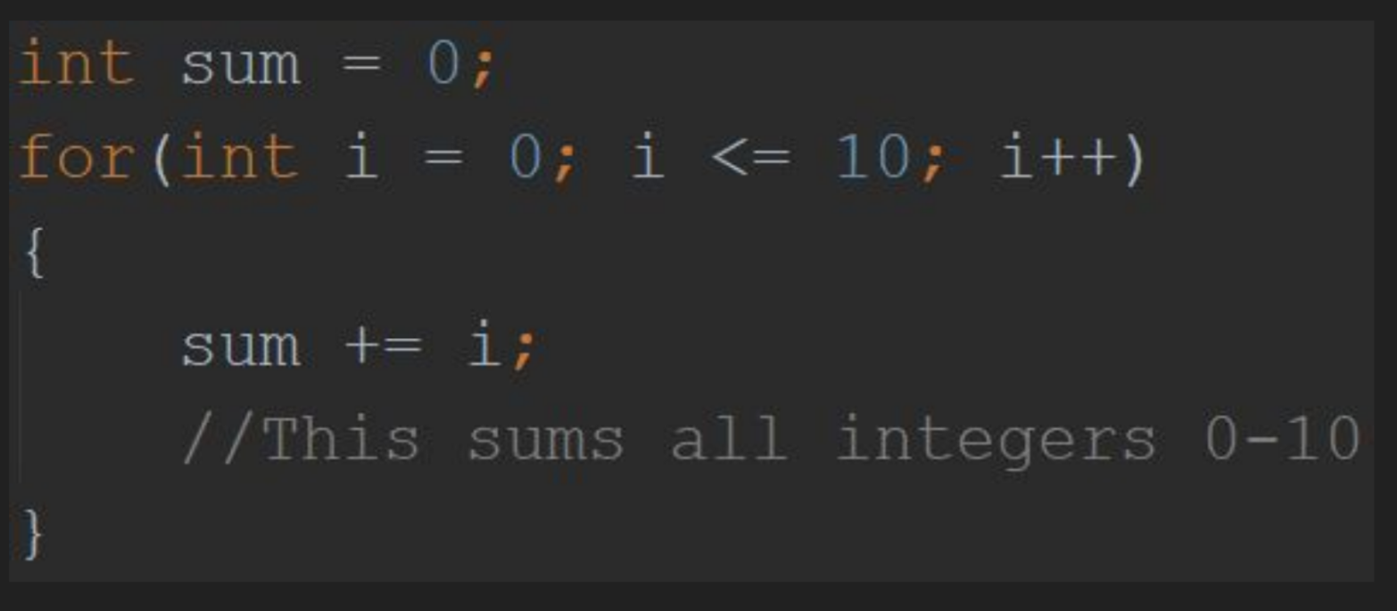
For Loops
The for loop is essentially just a while loop with a built in counter. You use a for loop when you know ahead of time exactly how many times you want to go through the loop.
The condition of the for loop consists of three statements
Initialization - This is where you create the variable that will be used to keep track of which iteration of the loop you are on (i.e. first time through the loop i == 1, second time i == 2, etc.)
Termination - Boolean expression which terminates the loop when false
Incrementation - increments the counter variable

Slide 31
Arrays
An array is a data structure that can hold a number of variables/objects of the same data type. The type of an array is specified by the type of the elements within the array, followed by an empty pair of square brackets ‘[]’ e.g. int[]
To access an individual ‘element’ of an array, you use square brackets ‘[]’ to specify the ‘index’, or offset from the beginning of the array, starting with 0.
Arrays are of a fixed size, if you try to access an index that is beyond the predefined size of the array (length - 1) an IndexOutOfBounds exception will be thrown.

Slide 32
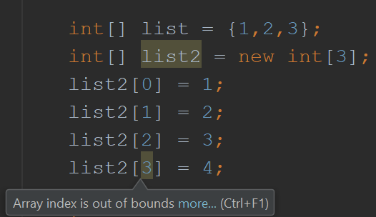
Arrays 2
You can initialize an array by using comma separated values (CSV) between a pair of curly braces ‘{}’.
You can also use the ‘new’ keyword to create an empty array, as shown in the code to the right.

Slide 33
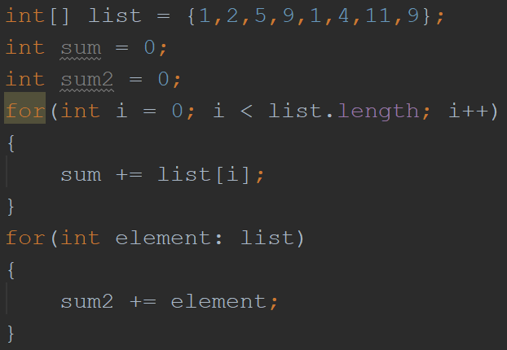
For Each Loop
A for each loop is a shorthand way of defining a for loop which iterates through each element of an array (or other iterable object, such as ArrayList)
The two loops shown to the right both iterate through each int in the list ‘sampleList’ and add it to the sum variable

Slide 34
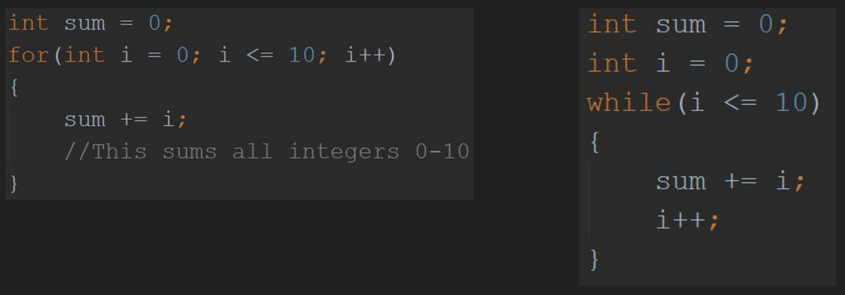
For/While Loop Example
Both of the below programs do the same thing, one is implemented with a for loop, the other with a while loop
[Code Here] [And also here]

Slide 35
Methods
Methods are sequences of code statements which perform a single operation and can be called or invoked by other sections of code.
Each method has what is known as a method signature which defines visibility, return type (output), name, and parameters (input).
There are three visibility modifiers in Java
Public - This is visible to anyone
Private - This is only visible within the same class
Protected - This is only visible within this class or subclasses of this class*
Classes will be covered later

Slide 36
Methods 2
The return type for a method can be any primitive data type, array, or class.
Methods can also not return a value, in this case the method signature will contain the keyword ‘void’ in place of a return type.
By convention, method names are written in camel case, and should describe what the method does.
Similarly to mathematical functions, the parameters (input) for Java methods are specified as comma separated values which are declared within parentheses following the method name. (e.g. f(x,y) )

Slide 37
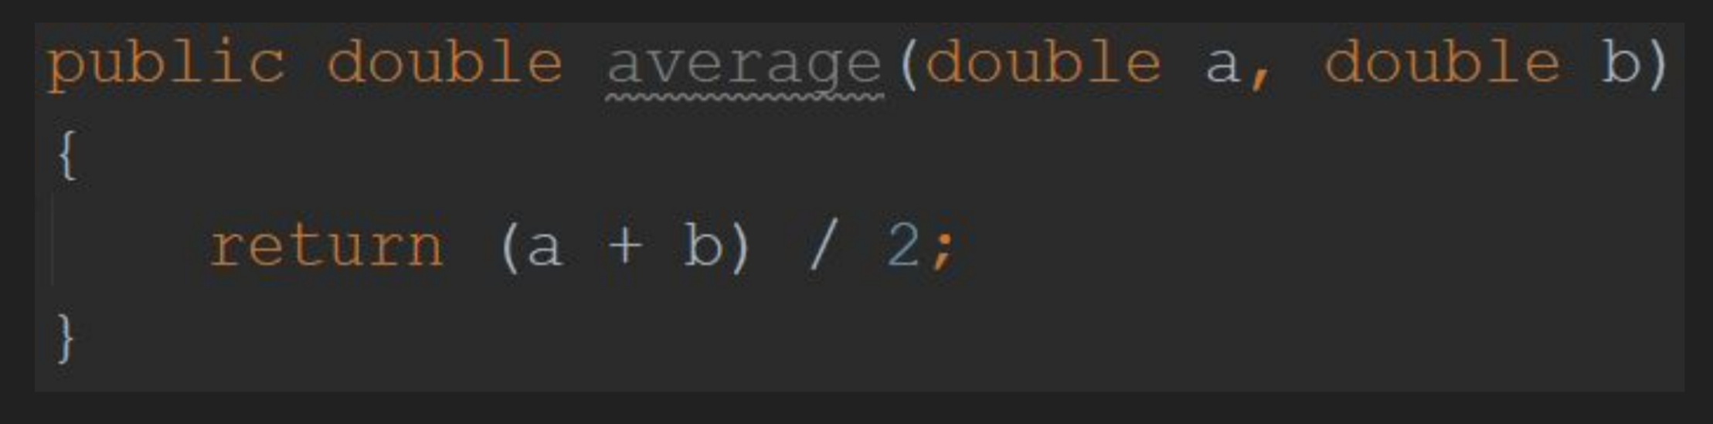
Methods 3
The below code defines a publically visible method ‘average’ which takes doubles ‘a’ and ‘b’ as parameters, and returns a double which is the average of ‘a’ and ‘b’
[Code here]

Slide 38
Exceptions
An exception is an event that disrupts or prevents program execution at runtime.
When an exception is created, or thrown, by a program certain information such as the type of exception and where it occurred are passed up to the next level of execution (This will be explained later, see Exceptions 2).
Exceptions are typically used to prevent undefined or unpredictable behavior from occurring, such as using null values or dividing by 0.
The next slide details some common exceptions you are likely to encounter.

Slide 39
Common Exceptions
IllegalStateException - Usually used when a method is invoked without fulfilling the prerequisite conditions
NullPointerException - Thrown when an application attempts to use an object that is null
ArithmeticException - Thrown when illegal math operations are performed (e.g. divide by zero)
IOException - Thrown when an IO operation fails or is interrupted
IllegalArgumentException - Thrown when a method is called with invalid input parameters

Slide 40
Using Objects and Classes
A ‘class’ is an entity in programming which represents and describes a type of thing.
An ‘object’ is a specific instance of a class
The concept of a book is an example of a class, whereas a specific book would be an object.
Classes can have numerous ‘fields’ which can store variables or objects, as well as methods which perform some operation.
By convention, class names are capitalized and object names use camel case

Slide 41
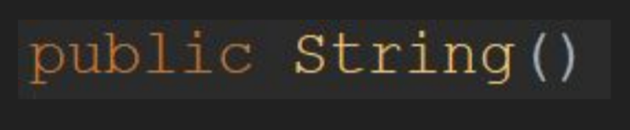
Using Objects and Classes 2
Objects must be declared and initialized just like variables.
Every class has what is known as a ‘constructor’ method which must be called with the ‘new’ operator to create an object of that class.
Constructor methods share the name of the class and do not specify a return type. (e.g. The constructor method for the String class has the following method signature)
The below code demonstrates how to create an Object of the String class

Slide 42
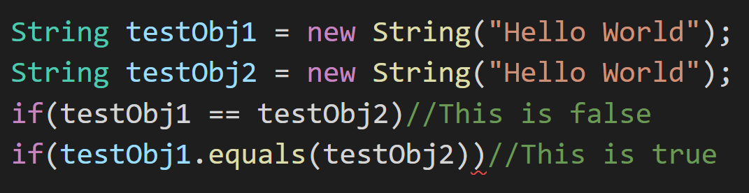
Testing Object Equality
When used with objects, the ‘==’ operator compares the memory addresses associated with the objects. This will only return true if both operands are the exact same object.
To test whether two objects have equivalent values, you should use the equals() method. This will return true if the two objects are deemed equivalent by whatever criteria is defined for that class.
[Here]

Slide 43
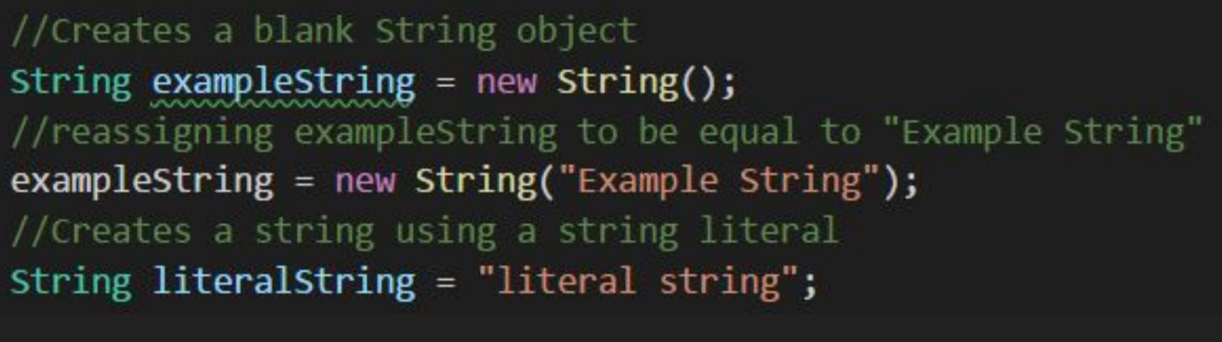
Strings
A String is a sequence of characters and can be used to represent text or store data such as a name.
A String object can be created like any other object, using ‘new’ and calling the constructor, or by assigning it to text within quotes (“).
Text that is within quotes (“”) is known as a ‘string literal’

Slide 44
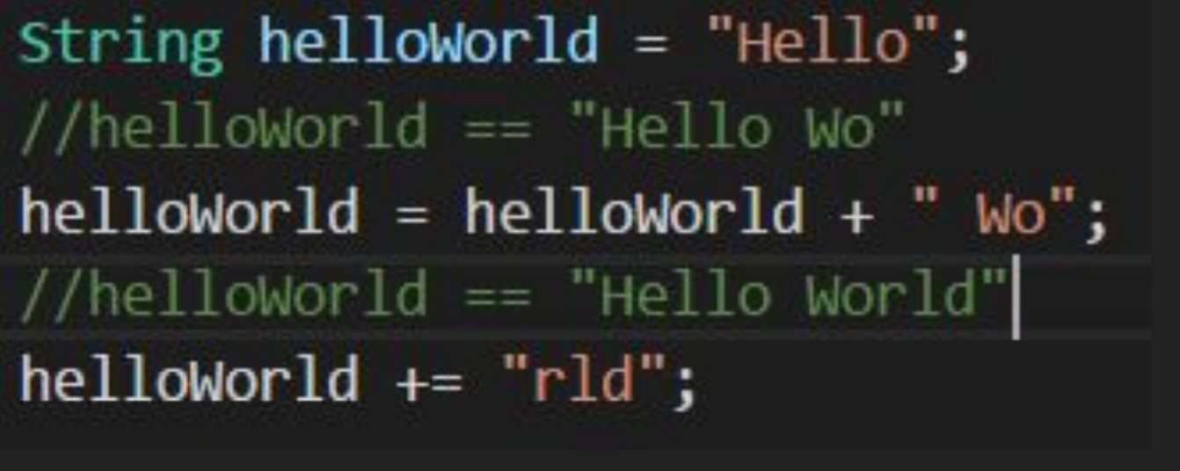
String Operators
Strings in Java have some unique behavior when used with common operators.
The ‘+’ operator can be used to concatenate (Append one to the other) two Strings. Similarly the ‘+=’ operator can be used to concatenate and assign strings in one statement.

Slide 45
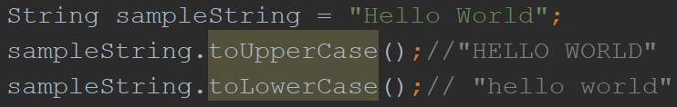
String Methods
The String class contains a number of extremely useful methods, only some of which will be covered here. Here is the complete API for Strings in Java 10.
toUpperCase() and toLowerCase() return a string with all upper/lowercase characters, “Hello World” becomes “HELLO WORLD” or “hello world”

Slide 46
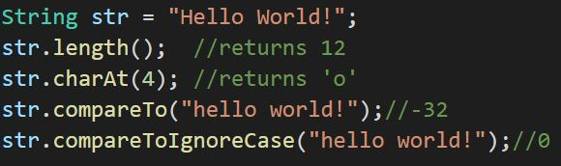
String Methods 2
length() returns the number of characters in a string as an int
charAt(int index) returns the char at the specified index of the string (starting at 0)
compareToIgnoreCase(String str) compares 2 strings ignoring upper/lowercase. Returns 0 if the Strings are equal

Slide 47
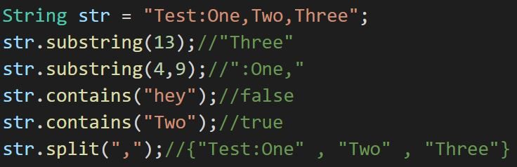
String Methods 3
substring(int beginIndex, int endIndex) returns a new string which is a substring of the original string from beginIndex (inclusive) to endIndex (exclusive). endIndex can be omitted, in this case the substring continues to the end of the original string
contains(String s) returns true if s is a substring of this string
split(String regex) returns an array of Strings, splitting the original string around matches of the given regular expression

Slide 48
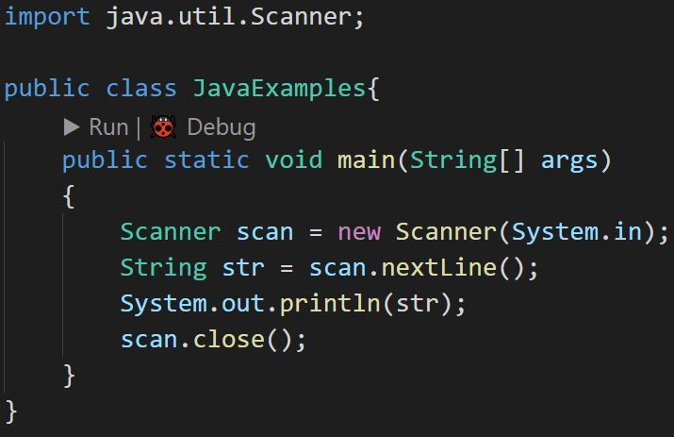
Importing Classes
Java classes are organized into packages. To use classes that are from a different package* you must first import them.
The code to the right shows how to import the Scanner class, which can read text from files or user input
*The java.lang package is always available. This contains classes like Object, String, Math, Integer, etc.

Slide 49
The Scanner Class
The Scanner constructor takes in a ‘source’ parameter of the File, InputStream (e.g. System.in), or String types (among others). This specifies where the Scanner will be reading from.
When you are finished using a Scanner you need to invoke the close() method. This is due to IO functions relying on OS level resources which do not have reliable garbage collection. Failure to close a Scanner or similar IO objects will result in a resource leak that can negatively impact system performance.
Scanners will break their source into ‘tokens’ which are separated by a ‘delimiter’. The default delimiter is a space or line break.

Slide 50
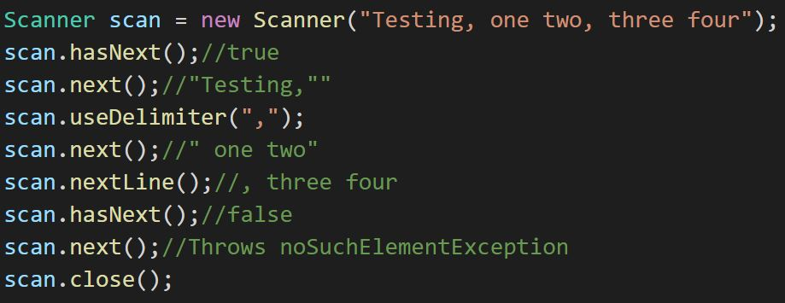
Scanner Methods
hasNext() returns true/false if the scanner has another token in its source
next() returns the next token from the source as a String
nextLine() returns the next line from the source as a String
useDelimiter(String pattern) changes the delimiter to use the given pattern instead of the default whitespace

Slide 51
ArrayList
//Arrays vs ArrayList, Mutable, Helpful Methods, Generics

Slide 52
Writing Classes

Slide 53
Exceptions 2
//Throwing an exception, Try/Catch blocks

Slide 54
The ‘static’ Modifier
By default, methods, fields, and classes need to be instantiated into an object to be used. This is because the values stored in fields and output from methods are often determined by data associated with the individual object.
The ‘static’ modifier tells us that the method/field/class belong to the class rather than a specific object, and that they can be used without instantiating an object. No matter how many instances of a class are created, there will only be one instance of any static fields.

Slide 55
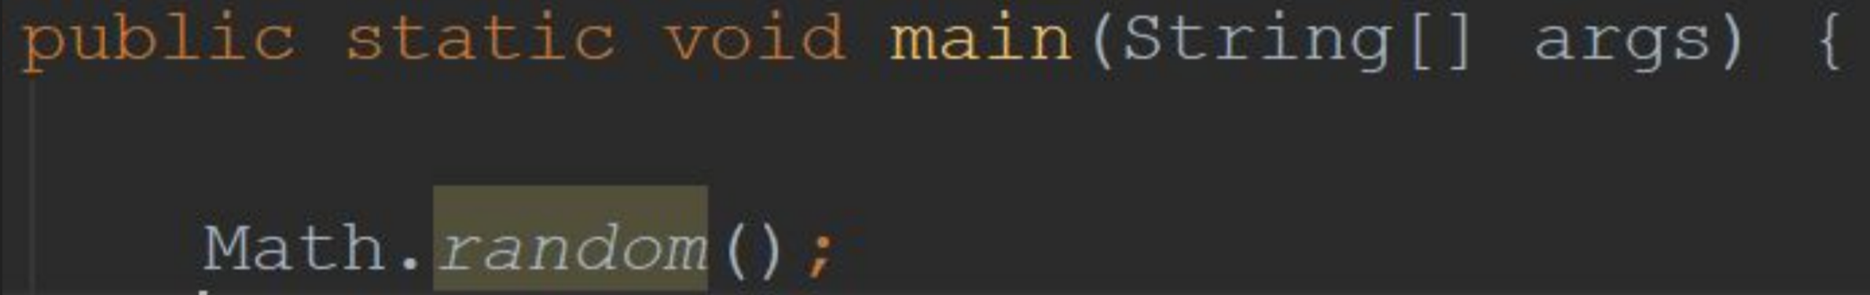
Using Static Fields and Methods
There are a lot of static methods which are used to provide general utility when programming. The below code demonstrates calling a static method from the Math class to generate a random double between 0 and 1. Note that Math is referring to a class, not an object.

Slide 56
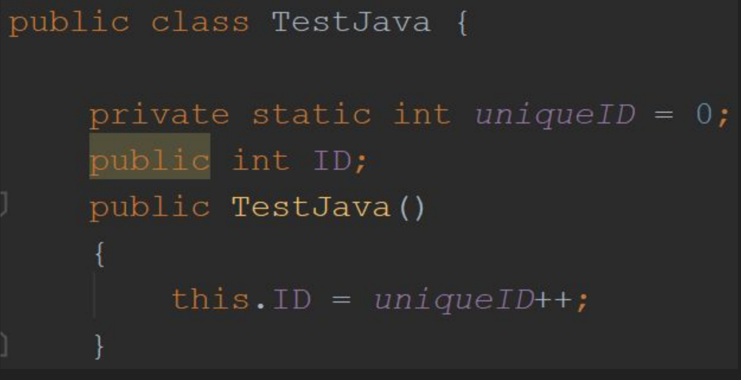
Using Static Fields and Methods 2
Static fields are shared between all instances of a class. This can be useful for constants that should have the same value, but can also be used in other ways.
The code to the right uses a static field to give each instance of the TestJava class a unique ID number. Since the uniqueID field is static, it will be changed across all instances of TestJava whenever the constructor is called.
[Code Here]

Slide 57
Static Classes

Slide 58
Enumerated Types

Slide 59
Inheritance (Subclasses)

Slide 60
Interfaces

Slide 61
Git and Version Control
Git is a Version Control System (VCS) which can be used to backup and manage large projects with numerous contributors.
A repository, or repo, is the collection of folders and files which are tracked as part of a project.
A commit is a change, or collection of changes, that have been made to the repository. By looking at the commit history of a project, developers can learn what changes were made when, by who, and why.
Commits can also be easily reverted if the changes are later found to cause bugs, or have other unintended side effects

Slide 62
Git 2
A branch is a separate version of the same codebase. For example typically projects have a ‘master’ branch alongside various branches for different features that are in development.
The ‘master’ branch should contain only fully functional code and features. This may also be considered a ‘production’ branch.
‘Development’ branches are used to track changes while a specific feature is being worked on. Code in these branches may not always be completely Functional.
A ‘merge’ is the process by which changes made in one branch are combined with those of another branch

Slide 63
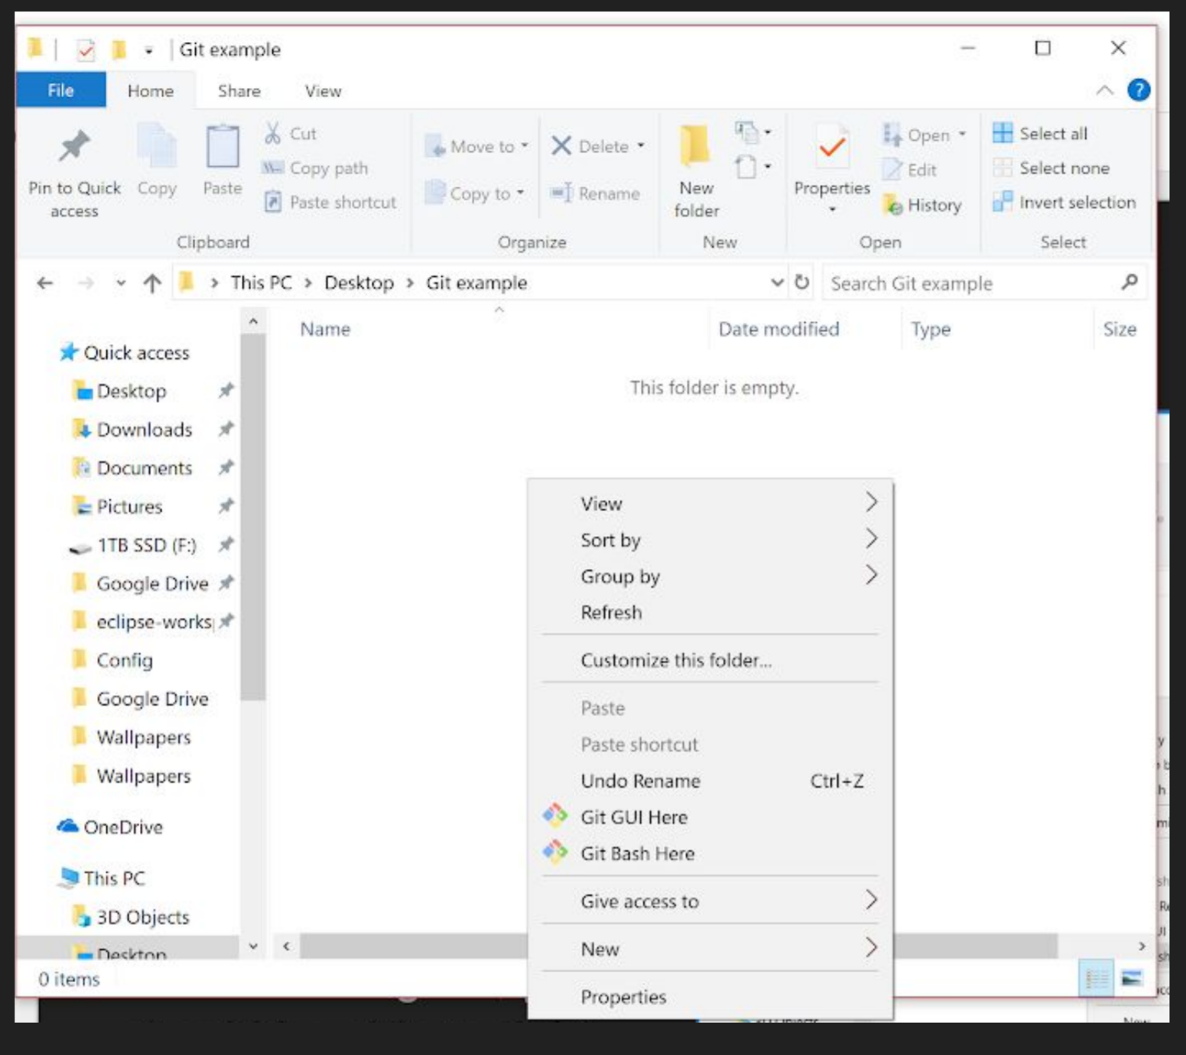
Setting Up Git
To setup a new Git repo, you will first need to download and run the installer (default settings are fine).
After installing Git, you should be able to right click and select the option “Git Bash Here” (pictured to the right). This will open a Command Line Interface (CLI) through which you can run git commands

Slide 64
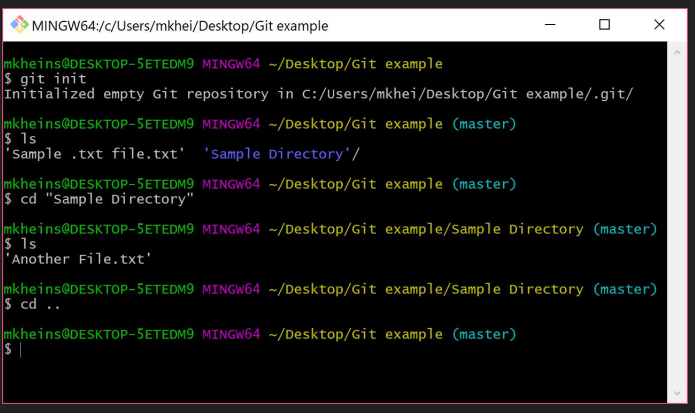
Useful Git Bash Commands
‘git init’ will initialize a new repository in the current directory (shown in yellow)
Every new project will have a single branch, ‘master’ (shown in blue)
‘Cd’,‘ls’, and ‘..’ are used to change directory, display what files/folders are in the current directory, and refer to the parent directory of the current directory

Slide 65
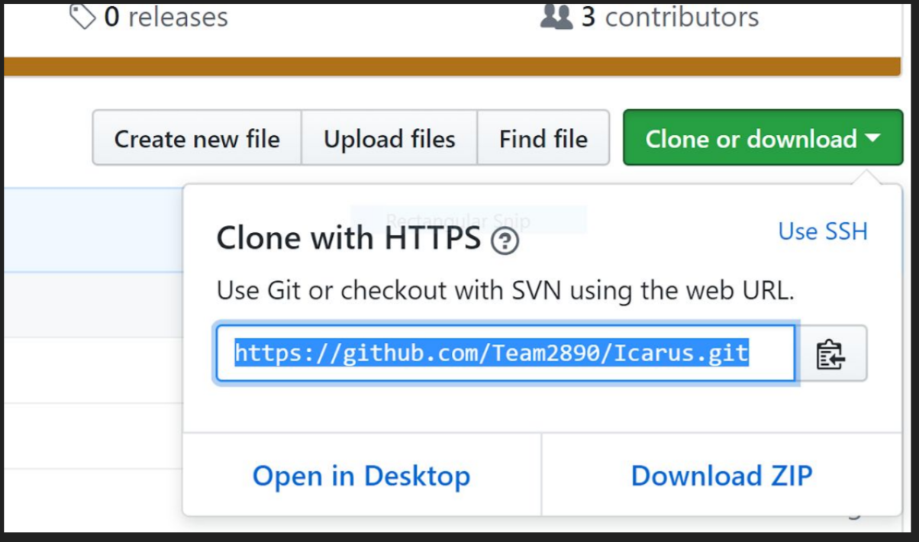
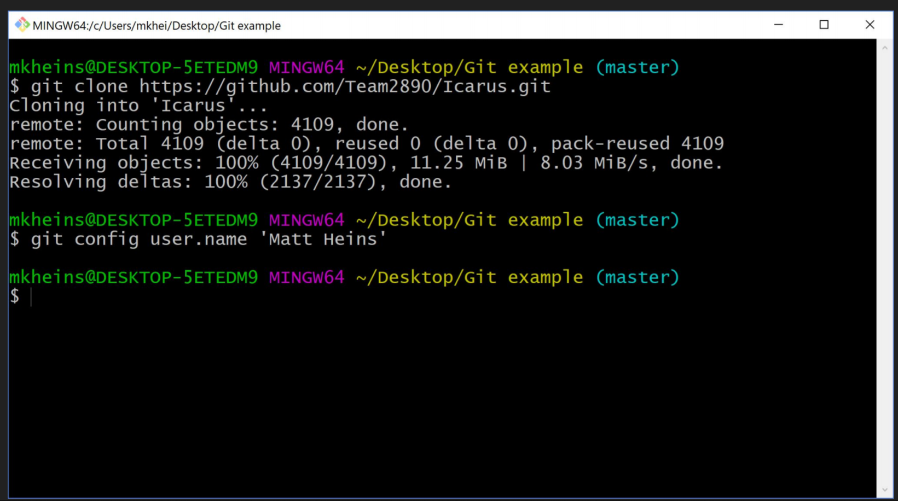
Useful Git Bash Commands 2
‘git clone ’ will copy the repository located at the https or ssh location specified by onto the local machine, creating a subdirectory of the current directory
‘git config user.name ’ will set the name that is recorded for all commits made on the local machine. This command can be rerun at any time to change the username

Slide 66
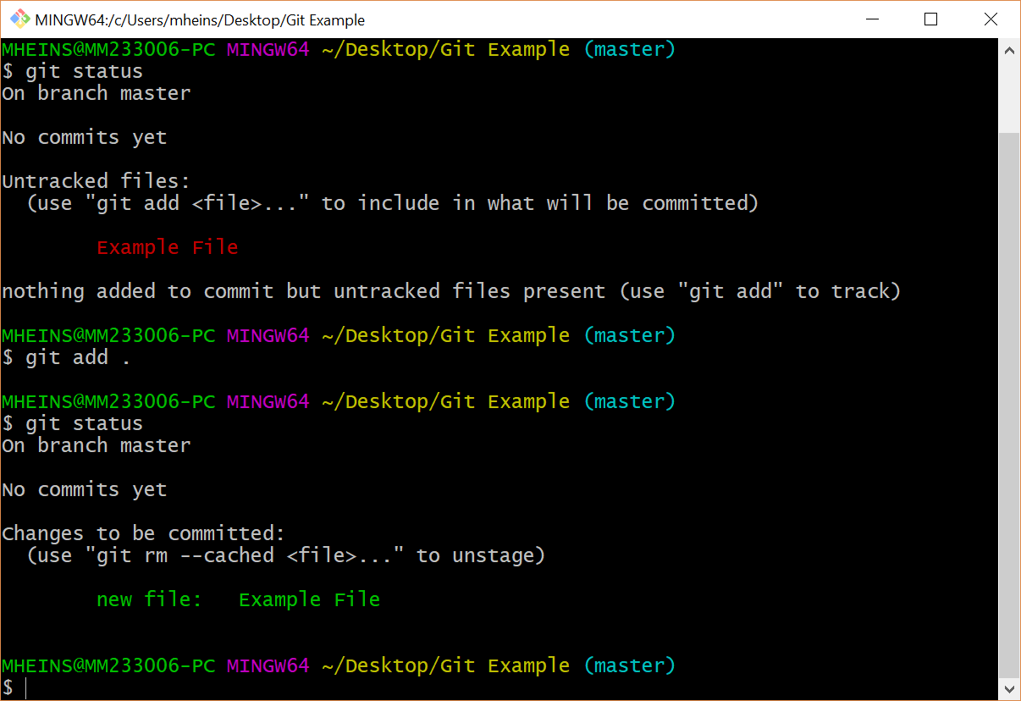
Useful Git Bash Commands 3
‘git status’ will show any staged or unstaged changes that have been made to the current directory. Unstaged changes will not be recorded if a commit is made.
‘git add .’ will stage all changes in the current directory, as well as all subdirectories. This should be done prior to running

Slide 67
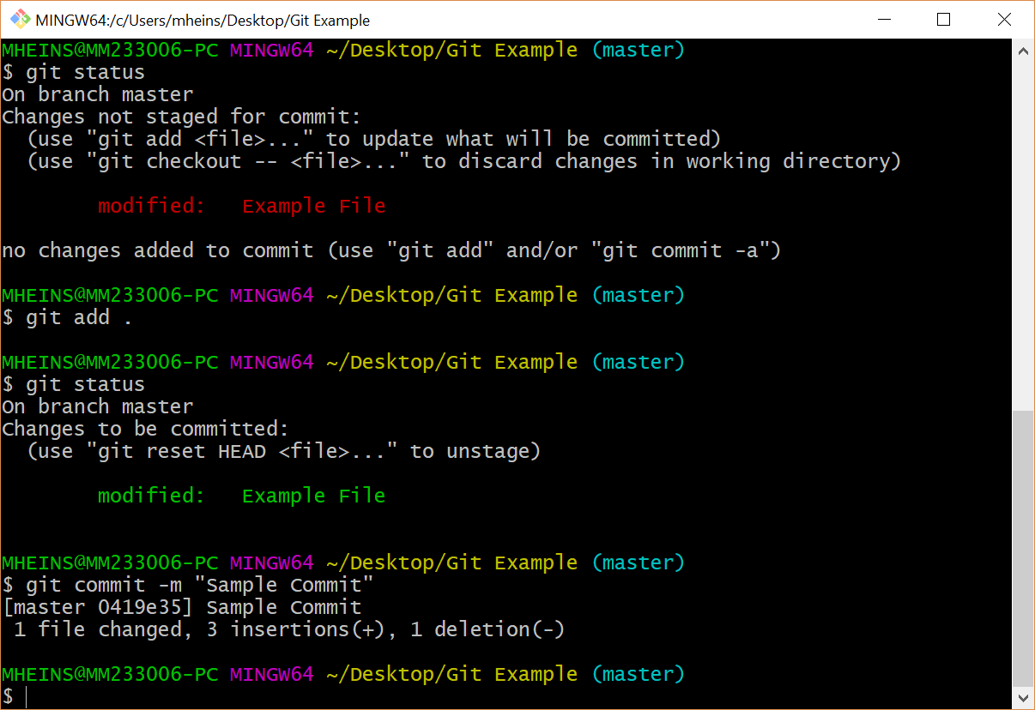
Useful Git Bash Commands 4
‘git commit -m “{x}”’ will commit the currently staged changes, with the commit message of {x}. The message should explain all changes made by the commit.
‘git push’ will upload the commits made to your local repo to the remote repo

Slide 68
Documentation
There are three types of documentation commonly used for Java programs
READMEs - Anyone should be able to read this to know WHAT your program is.
JavaDocs - Any developer should be able to read these to know WHAT each field/method/class in your code is used for.
Code comments - Anyone familiar with the language should be read these to know HOW your code works.
Ideally you should have up-to-date versions of all three types of documentation at all times for any code that you are writing.

Slide 69
READMEs

Slide 70
JavaDocs

Slide 71
Code Comments

Slide 72
Robot Code
//TODO add tutorials for robot specific code, frequently used classes, structure diagrams, external utilities such as driver station etc.

Slide 73
Useful Resources
FIRST Programming Resources Page - Instructions on how to setup your environment, along with various guides on how to program the robot using Java
Java 8 API - Complete documentation for the standard Java library version 8
Java 10 API - Complete documentation for the standard Java library version 10
StackOverFlow - Q&A website used for crowdsourced troubleshooting, if you have a problem you can’t figure out 80% chance it’s on here somewhere
Team2890 Github Account - Official Team GitHub account
Team Github Page - GitHub team, containing team documentation/training materials

Slide 74
Useful Resources 2
Git Handbook - Additional reading material on Git
Google - Google is your friend

